Slide 1
1CWK50
Kian Naidoo
Student ID : 24793951
There are some comments in the Notes pane, below – make sure you read them

Slide 2
k-nearest neighbours classifier

Slide 3
1. fit()
=
=
Notes:
This slide is here as a reminder that you need to deal with both the fitting and prediction phases for each model – you can delete it at your own discretion.

Slide 4


Notes:
Add as many more slides as you need… Remember: no words(!) and all visuals must be created either with PowerPoint’s built-in tools (e.g., Shapes, Icons, and freehand drawing) or from images you personally authored (e.g., figures generated using Python code in labs).

Slide 5
2. predict()
Notes:
This slide is here as a reminder that you need to deal with both the fitting and prediction phases for each model – you can delete it at your own discretion.

Slide 6
=
=
Notes:
Add as many more slides as you need… Remember: no words(!) and all visuals must be created either with PowerPoint’s built-in tools (e.g., Shapes, Icons, and freehand drawing) or from images you personally authored (e.g., figures generated using Python code in labs).

Slide 7
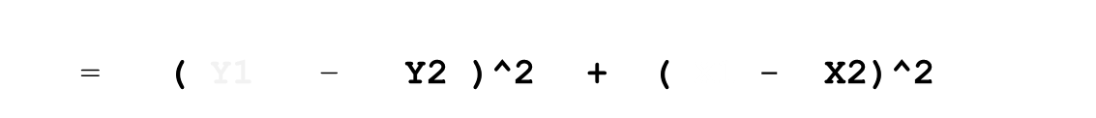
= ( Y1 – Y2 )^2 + ( X1 - X2)^2
Y1
Y2
X1 X2
Notes:
Add as many more slides as you need… Remember: no words(!) and all visuals must be created either with PowerPoint’s built-in tools (e.g., Shapes, Icons, and freehand drawing) or from images you personally authored (e.g., figures generated using Python code in labs).

Slide 8
K = 1
K = 5
=
=
Notes:
Add as many more slides as you need… Remember: no words(!) and all visuals must be created either with PowerPoint’s built-in tools (e.g., Shapes, Icons, and freehand drawing) or from images you personally authored (e.g., figures generated using Python code in labs).

Slide 9
K = 5
= 3
= 2
=
=
=
Notes:
Add as many more slides as you need… Remember: no words(!) and all visuals must be created either with PowerPoint’s built-in tools (e.g., Shapes, Icons, and freehand drawing) or from images you personally authored (e.g., figures generated using Python code in labs).

Slide 10
K = 2 ?
K = 2
= 1
= 1
(2)
(3)
2 < 3
Notes:
Add as many more slides as you need… Remember: no words(!) and all visuals must be created either with PowerPoint’s built-in tools (e.g., Shapes, Icons, and freehand drawing) or from images you personally authored (e.g., figures generated using Python code in labs).

Slide 11
naïve Bayes classifier

Slide 12
1. fit()
=
=
Notes:
This slide is here as a reminder that you need to deal with both the fitting and prediction phases for each model – you can delete it at your own discretion.

Slide 13
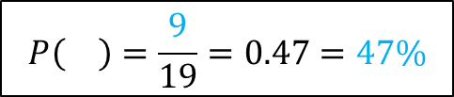
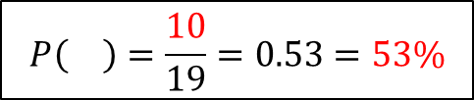
$$P\left(\right)=\frac{10}{19}=0.53=53\%$$
$$P\left(\right)=\frac{9}{19}=0.47=47\%$$
= 10
= 9
Notes:
This slide is here as a reminder that you need to deal with both the fitting and prediction phases for each model – you can delete it at your own discretion.

Slide 14
μ₁
μ₂
σ₁
σ₂
Notes:
Add as many more slides as you need… Remember: no words(!) and all visuals must be created either with PowerPoint’s built-in tools (e.g., Shapes, Icons, and freehand drawing) or from images you personally authored (e.g., figures generated using Python code in labs).

Slide 15
F2
F1
μ₄
μ₁
μ₃
μ₂
σ₃
σ₄
σ₁
σ₂
Notes:
Add as many more slides as you need… Remember: no words(!) and all visuals must be created either with PowerPoint’s built-in tools (e.g., Shapes, Icons, and freehand drawing) or from images you personally authored (e.g., figures generated using Python code in labs).

Slide 16
2. predict()
Notes:
This slide is here as a reminder that you need to deal with both the fitting and prediction phases for each model – you can delete it at your own discretion.

Slide 17
F2
F1
μ₄
μ₁
μ₃
μ₂
σ₃
σ₄
σ₁
σ₂
F1( ( )) = 2
F1( ( )) = 0.2
F2( ( )) = 2.5
F2( ( )) = 3.8
Notes:
Add as many more slides as you need… Remember: no words(!) and all visuals must be created either with PowerPoint’s built-in tools (e.g., Shapes, Icons, and freehand drawing) or from images you personally authored (e.g., figures generated using Python code in labs).

Slide 18
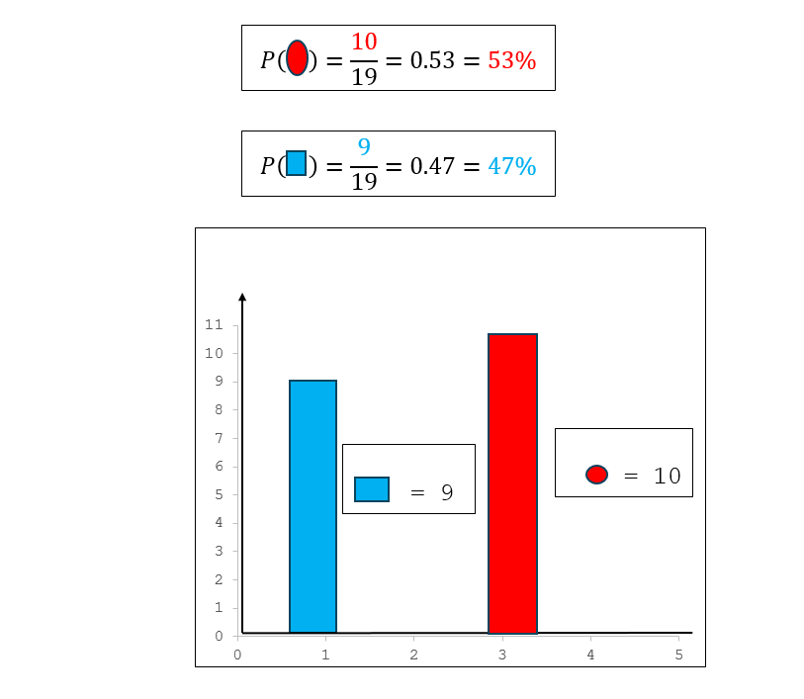
F2
F1
μ₄
μ₁
μ₃
μ₂
σ₃
σ₄
σ₁
σ₂
U
F1( ( )) = 2
F1( ( )) = 0.2
F2( ( )) = 2.5
F2( ( )) = 3.8
Notes:
Add as many more slides as you need… Remember: no words(!) and all visuals must be created either with PowerPoint’s built-in tools (e.g., Shapes, Icons, and freehand drawing) or from images you personally authored (e.g., figures generated using Python code in labs).

Slide 19
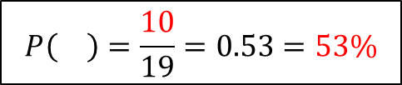
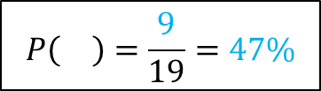
$$P\left(\right)=\frac{9}{19}=47\%$$
F1( ( )) = 2
F2( ( )) = 2.5
(0.47)
(2)
(2.5)
2.35
F1( ( )) = 0.2
$$P\left(\right)=\frac{10}{19}=0.53=53\%$$
F2( ( )) = 3.8
(0.53)
(0.2)
(3.8)
0.40
2.35
0.40
>
Notes:
Add as many more slides as you need… Remember: no words(!) and all visuals must be created either with PowerPoint’s built-in tools (e.g., Shapes, Icons, and freehand drawing) or from images you personally authored (e.g., figures generated using Python code in labs).

Slide 20
decision tree classifier

Slide 21
1. fit()
=
=
Notes:
This slide is here as a reminder that you need to deal with both the fitting and prediction phases for each model – you can delete it at your own discretion.

Slide 22
Y
F1
X
X > 2.6 ?
Notes:
This slide is here as a reminder that you need to deal with both the fitting and prediction phases for each model – you can delete it at your own discretion.

Slide 23
F1
X > 2.6 ?
X < 2.6
X > 2.6
Notes:
Add as many more slides as you need… Remember: no words(!) and all visuals must be created either with PowerPoint’s built-in tools (e.g., Shapes, Icons, and freehand drawing) or from images you personally authored (e.g., figures generated using Python code in labs).

Slide 24
Y
F2
Y > 0.4
X
F1
X > 2.6
Notes:
This slide is here as a reminder that you need to deal with both the fitting and prediction phases for each model – you can delete it at your own discretion.

Slide 25
F1
X > 2.6 ?
X < 2.6
X > 2.6
F2
Y > 0.4 ?
X > 2.6 & Y < 0.4
X > 2.6 & Y > 0.4
Notes:
This slide is here as a reminder that you need to deal with both the fitting and prediction phases for each model – you can delete it at your own discretion.

Slide 26
X > 2.6
=
=
X < 2.6 ?
X > 2.6 ?
< 2.6 ?
Y < 0.4 ?
Y > 0.4 ?
=
=
Notes:
Add as many more slides as you need… Remember: no words(!) and all visuals must be created either with PowerPoint’s built-in tools (e.g., Shapes, Icons, and freehand drawing) or from images you personally authored (e.g., figures generated using Python code in labs).

Slide 27
2. predict()
Notes:
This slide is here as a reminder that you need to deal with both the fitting and prediction phases for each model – you can delete it at your own discretion.

Slide 28
X =( 3.2 ) / Y = (0.3)
Y
F2
Y > 0.4 ?
(0.3)
F1
(3.2)
X
X > 2.6 ?
Notes:
This slide is here as a reminder that you need to deal with both the fitting and prediction phases for each model – you can delete it at your own discretion.

Slide 29
X
3.2
X < 2.6
( (X)= 3.2 & (Y) = 0.3 )
Y
0.3
X < 2.6 ?
X > 2.6 ?
< 2.6 ?
Y < 0.4 ?
Y > 0.4 ?
=
( X > 2.6 & Y < 0.4 )
Notes:
Add as many more slides as you need… Remember: no words(!) and all visuals must be created either with PowerPoint’s built-in tools (e.g., Shapes, Icons, and freehand drawing) or from images you personally authored (e.g., figures generated using Python code in labs).

Slide 30
ensemble classifier
Notes:
Note: there are lots of different types of ensemble classifier – this section is a chance for you to go as far/deep as you like. (E.g., if you’re aiming for top marks.)

Slide 31
1. fit()
=
=
Notes:
This slide is here as a reminder that you need to deal with both the fitting and prediction phases for each model – you can delete it at your own discretion.

Slide 32
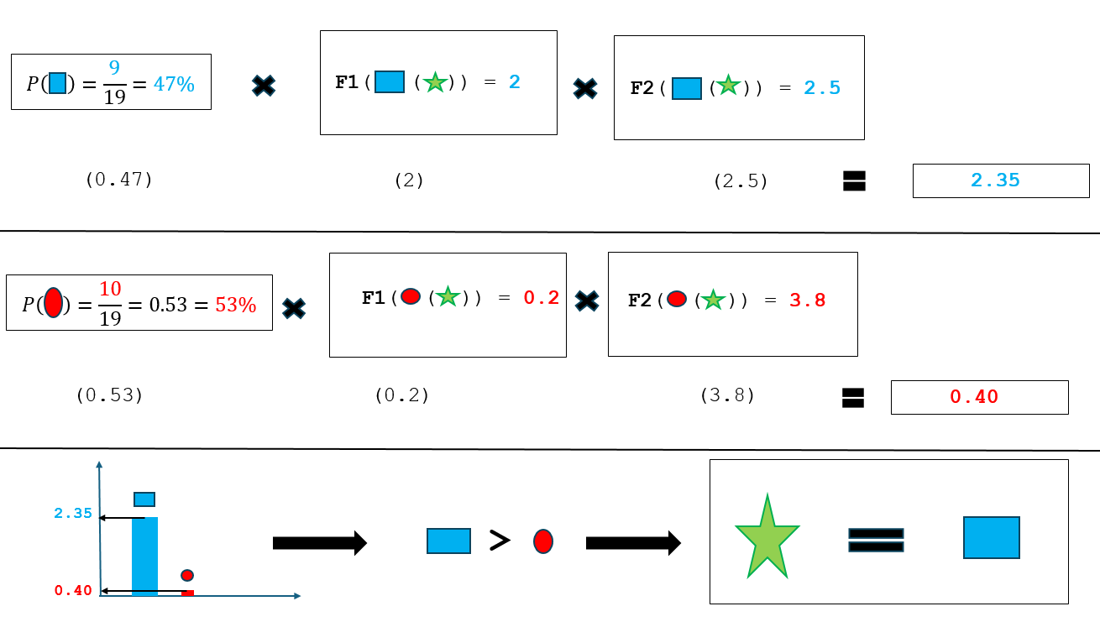
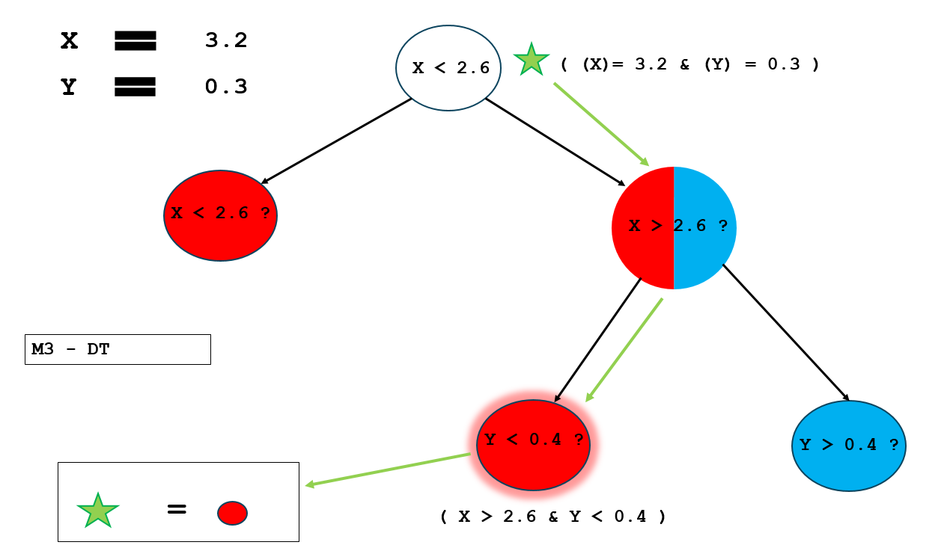
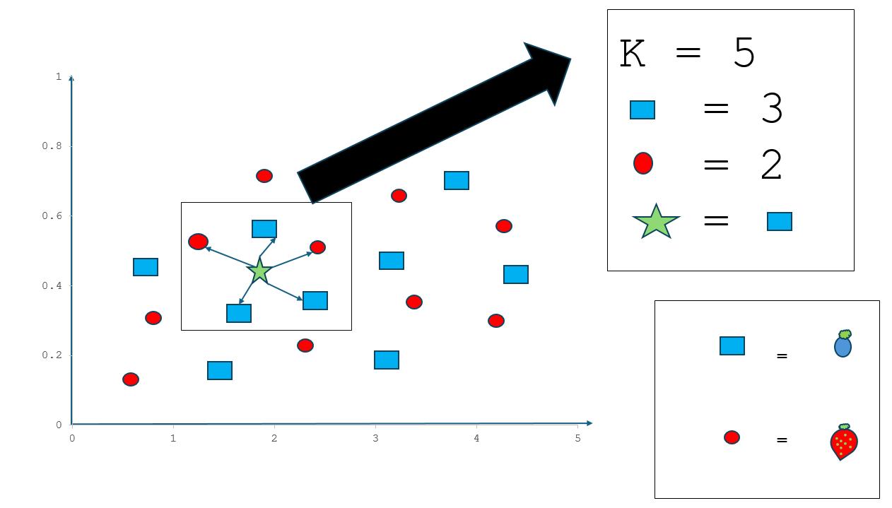
M1 - KNN
M2 - NB
M3 - DT
U
?
Notes:
Add as many more slides as you need… Remember: no words(!) and all visuals must be created either with PowerPoint’s built-in tools (e.g., Shapes, Icons, and freehand drawing) or from images you personally authored (e.g., figures generated using Python code in labs).

Slide 33
2. predict()
Notes:
This slide is here as a reminder that you need to deal with both the fitting and prediction phases for each model – you can delete it at your own discretion.

Slide 34
M1 - KNN
M2 - NB
M3 - DT
Notes:
Add as many more slides as you need… Remember: no words(!) and all visuals must be created either with PowerPoint’s built-in tools (e.g., Shapes, Icons, and freehand drawing) or from images you personally authored (e.g., figures generated using Python code in labs).

Slide 35
?
HV
M1 - KNN
M2 - NB
M3 - DT
U
U
2.0
1.0
>
Notes:
Add as many more slides as you need… Remember: no words(!) and all visuals must be created either with PowerPoint’s built-in tools (e.g., Shapes, Icons, and freehand drawing) or from images you personally authored (e.g., figures generated using Python code in labs).

Slide 36
1. fit()
=
=
Notes:
This slide is here as a reminder that you need to deal with both the fitting and prediction phases for each model – you can delete it at your own discretion.

Slide 37
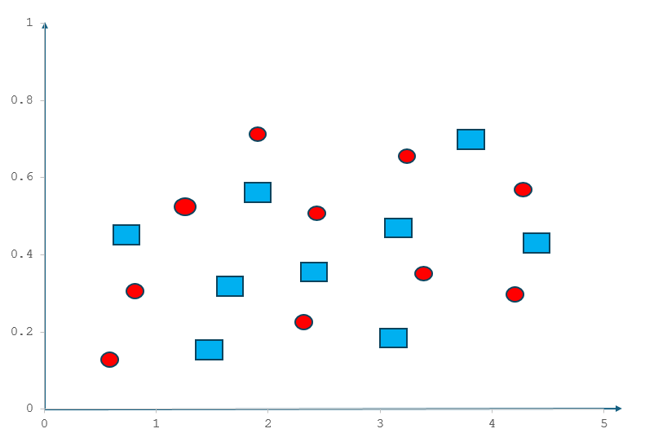
BG
M1 - KNN
M2 - NB
M3 - DT
Notes:
Add as many more slides as you need… Remember: no words(!) and all visuals must be created either with PowerPoint’s built-in tools (e.g., Shapes, Icons, and freehand drawing) or from images you personally authored (e.g., figures generated using Python code in labs).

Slide 38
M1 - KNN
M2 - NB
M3 - DT
Notes:
Add as many more slides as you need… Remember: no words(!) and all visuals must be created either with PowerPoint’s built-in tools (e.g., Shapes, Icons, and freehand drawing) or from images you personally authored (e.g., figures generated using Python code in labs).

Slide 39
2. predict()
Notes:
This slide is here as a reminder that you need to deal with both the fitting and prediction phases for each model – you can delete it at your own discretion.

Slide 40
M1 - KNN
M2 - NB
M3 - DT
P( ) = 0.5 |
P( ) = 0.5
P( ) = 0.45 |
P( ) = 0.55
P( ) = 0.45 |
P( ) = 0.55
0.6
0.4
0.55
0.45
0.5
Notes:
Add as many more slides as you need… Remember: no words(!) and all visuals must be created either with PowerPoint’s built-in tools (e.g., Shapes, Icons, and freehand drawing) or from images you personally authored (e.g., figures generated using Python code in labs).

Slide 41
M1 - KNN
M2 - NB
M3 - DT
P( ) = 0.5 /
P( ) = 0.5
P( ) = 0.4 /
P( ) = 0.6
P( ) = 0.45 /
P( ) = 0.55
0.6
0.4
0.55
0.45
0.5
(KNN) (NB) (DT)
P( ) = ((0.5 + 0.45 + 0.45) 3)
0.46
>
(KNN) (NB) (DT)
P( ) = ((0.5 + 0.55 + 0.55) 3)
0.53
Notes:
Add as many more slides as you need… Remember: no words(!) and all visuals must be created either with PowerPoint’s built-in tools (e.g., Shapes, Icons, and freehand drawing) or from images you personally authored (e.g., figures generated using Python code in labs).

Slide 42
1. fit()
=
=
Notes:
This slide is here as a reminder that you need to deal with both the fitting and prediction phases for each model – you can delete it at your own discretion.

Slide 43
M1 - KNN
M2 - NB
M3 - DT
Notes:
Add as many more slides as you need… Remember: no words(!) and all visuals must be created either with PowerPoint’s built-in tools (e.g., Shapes, Icons, and freehand drawing) or from images you personally authored (e.g., figures generated using Python code in labs).

Slide 44
BG + RF
T1
T2
T3
Notes:
Add as many more slides as you need… Remember: no words(!) and all visuals must be created either with PowerPoint’s built-in tools (e.g., Shapes, Icons, and freehand drawing) or from images you personally authored (e.g., figures generated using Python code in labs).

Slide 45
2. predict()
Notes:
This slide is here as a reminder that you need to deal with both the fitting and prediction phases for each model – you can delete it at your own discretion.

Slide 46
T1
T2
T3
/
/
U
U
Notes:
Add as many more slides as you need… Remember: no words(!) and all visuals must be created either with PowerPoint’s built-in tools (e.g., Shapes, Icons, and freehand drawing) or from images you personally authored (e.g., figures generated using Python code in labs).

Slide 47
1. fit()
=
=
Notes:
This slide is here as a reminder that you need to deal with both the fitting and prediction phases for each model – you can delete it at your own discretion.

Slide 48
M1 - KNN
M2 - NB
M3 - DT
Notes:
Add as many more slides as you need… Remember: no words(!) and all visuals must be created either with PowerPoint’s built-in tools (e.g., Shapes, Icons, and freehand drawing) or from images you personally authored (e.g., figures generated using Python code in labs).

Slide 49
M1 - KNN
M2 - NB
M3 - DT
y
y
y
x
x
x
W1
W2
Notes:
Add as many more slides as you need… Remember: no words(!) and all visuals must be created either with PowerPoint’s built-in tools (e.g., Shapes, Icons, and freehand drawing) or from images you personally authored (e.g., figures generated using Python code in labs).

Slide 50
2. predict()
Notes:
This slide is here as a reminder that you need to deal with both the fitting and prediction phases for each model – you can delete it at your own discretion.

Slide 51
M1 - KNN
M2 - NB
M3 - DT
y
y
y
x
x
x
X = 3.2
Notes:
Add as many more slides as you need… Remember: no words(!) and all visuals must be created either with PowerPoint’s built-in tools (e.g., Shapes, Icons, and freehand drawing) or from images you personally authored (e.g., figures generated using Python code in labs).

Slide 52
?
X1 = 3.2
X1 < 2 ?
M1 – KNN
X1 < 2.5?
M2 - NB
X1 < 1.5 ?
M3 - DT
Y
N
Y
N
W2 = 0.3
Y
N
W1 = 0.8
W3 = 0.6
0.8
0.3 0.6 = 0.18
0.18 > 0.8
Notes:
Add as many more slides as you need… Remember: no words(!) and all visuals must be created either with PowerPoint’s built-in tools (e.g., Shapes, Icons, and freehand drawing) or from images you personally authored (e.g., figures generated using Python code in labs).

Slide 53
References
Weekly Moodle research questions
PowerPoint built-in tools – Shapes, lines, colour etc.
Desmos ( Normal distribution plot) - https://www.desmos.com/calculator/jxzs8fz9qr
Co-pilot
What is ensemble learning? https://www.ibm.com/think/topics/ensemble-learning
What is a decision tree? https://www.ibm.com/think/topics/decision-trees
Notes:
You’re not expected to have lots of references. But if you do draw on particular sources for information or ideas, then you should cite/reference them. This includes the source files for any self-authored images. You need to use Cite Them Right Harvard – MMU library guidance here: https://www.mmu.ac.uk/library/referencing-and-study-support/citing-and-referencing/cite-them-right-Harvard
You can include the citations in the Notes panel underneath the relevant slide(s) with a brief note explaining the relevance of the reference.
If you have used other software to author an image in one of your slides, then you should cite/reference the original file you used to generate the image, and include a link. For example, if you generated the image by writing Python code, then you should cite/reference your original notebook and include a Colab link. If you generated the image using Excel, or using Paint3D, or using any other program, then you should cite/reference your original file, and link to a copy stored on your OneDrive. In all cases, the file sharing needs to be set to “anyone with the link” so that markers can access your work.

